Slide 1
AWS (Amazon Web Services) - Demo

Slide 2
Agenda
Cloud
What is Cloud
Advantages of Cloud Computing
Service Models
Deployment Models
AWS
What is AWS
Why AWS
AWS Global Infrastructure
AWS Advantages
AWS Services
AWS vs Azure vs GCP
AWS Course Content
Queries & Answers

Slide 3
What is Cloud ?
It is a practice of using remote servers on the internet for carrying out tasks rather than using our own computers/servers
Cloud Computing is the on-demand delivery of compute power, database storage, applications, and other IT resources through a cloud services platform via the internet with pay as you go pricing method

Slide 4
Advantages of Cloud Computing
Trade capital expense for variable expense – Instead of having to invest heavily in data centers and servers before you know how you’re going to use them, you can pay only when you consume computing resources, and pay only for how much you consume.
Benefit from massive economies of scale – By using cloud computing, you can achieve a lower variable cost than you can get on your own. Because usage from hundreds of thousands of customers is aggregated in the cloud, providers such as AWS can achieve higher economies of scale, which translates into lower pay as-you-go prices.
Stop guessing capacity – Eliminate guessing on your infrastructure capacity needs. When you make a capacity decision prior to deploying an application, you often end up either sitting on expensive idle resources or dealing with limited capacity. With cloud computing, these problems go away. You can access as much or as little capacity as you need, and scale up and down as required with only a few minutes’ notice.
Increase speed and agility – In a cloud computing environment, new IT resources are only a click away, which means that you reduce the time to make those resources available to your developers from weeks to just minutes. This results in a dramatic increase in agility for the organization, since the cost and time it takes to experiment and develop is significantly lower.
Stop spending money running and maintaining data centers – Focus on projects that differentiate your business, not the infrastructure. Cloud computing lets you focus on your own customers, rather than on the heavy lifting of racking, stacking, and powering servers.
Go global in minutes – Easily deploy your application in multiple regions around the world with just a few clicks. This means you can provide lower latency and a better experience for your customers at minimal cost.

Slide 5
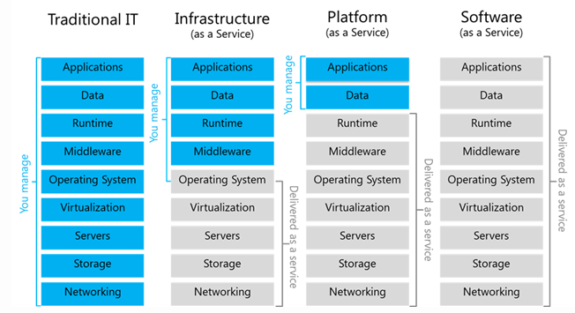
Service Models

Slide 6
Deployment Models
Public Cloud
- provisioned for open use - it is owned , managed and operated by a business, academic or government organizations
Private Cloud
- provisioned for exclusive use by a single organization comprising multiple consumers - it is owned , managed and operated by organization.
Hybrid Cloud
– This infrastructure is a combination of two or more distinct cloud infrastructures
Community Cloud
– This is a multi-tenant infrastructure that is shared among several organizations from a specific group

Slide 7
What is AWS ?
AWS Amazon web services is a secure cloud services platform offering compute power, database storage, content delivery and other functionality
With the pay as you go system there is no requirement for upfront capital
Available in matter of seconds
Helps in controlling auditing and managing identity , configuration and usage
Easily available when required
Offers 150+ cloud applications with features.

Slide 8
AWS Global Infrastructure
AWS serves over a million active customers in more than 190 countries. AWS global infrastructure achieve lower latency and higher throughput, and it will ensure the data resides only in the AWS Region specified by customers.
The AWS Cloud infrastructure is built around AWS Regions and Availability Zones.
An AWS Region is a physical location in the world where we have multiple Availability Zones.
Availability Zones consist of one or more discrete data centers, each with redundant power, networking, and connectivity, housed in separate facilities. These Availability Zones offer you the ability to operate production applications and databases that are more highly available, fault tolerant, and scalable than would be possible from a single data center. The AWS Cloud operates in 77 Availability Zones within 24 geographic Regions around the world.
Each Amazon Region is designed to be completely isolated from the other Amazon Regions. This achieves the greatest possible fault tolerance and stability. Each Availability Zone is isolated, but the Availability Zones in a Region are connected through low-latency links. AWS provides you with the flexibility to place instances and store data within multiple geographic regions as well as across multiple Availability Zones within each AWS Region. Each Availability Zone is designed as an independent failure zone.

Slide 9
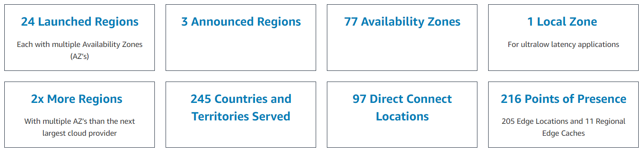
AWS Global Infrastructure
https://www.infrastructure.aws/

Slide 10
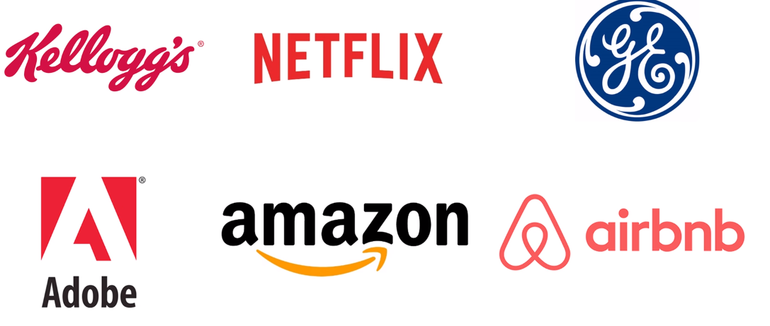
Enterprises Using AWS cloud

Slide 11
Why AWS ?
AWS Provides…
Security
– It is a secure and durable platform which provides end to end privacy and end to end security and storage
Flexibility
– Allows the users to select the OS languages , database and other services
Easy to use
– Host your applications quickly and securely whether an existing application or a new one
Scalability
– The application can be easily scaled up or down depending on user requirement.
Cost Savings
– Only pay for the compute power storage and other resources . You use without any long term commitments.

Slide 12
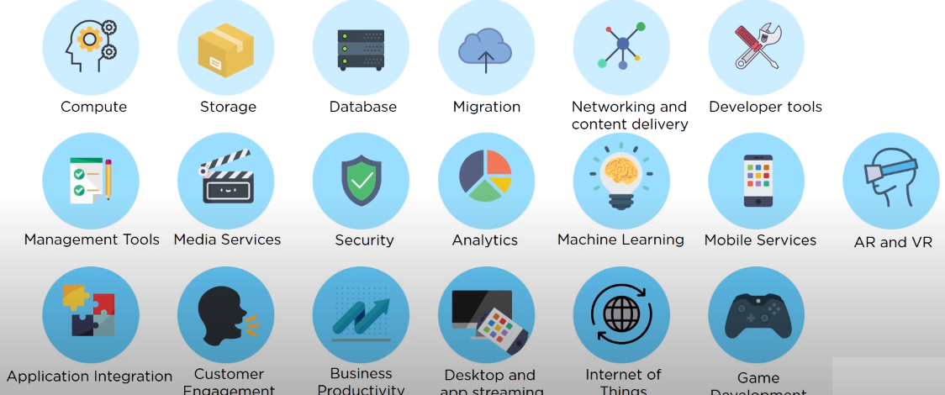
AWS Services
AWS Provides..

Slide 13
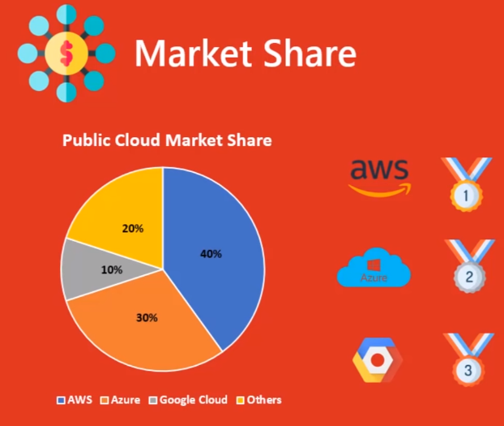
AWS vs Azure vs GCP

Slide 14
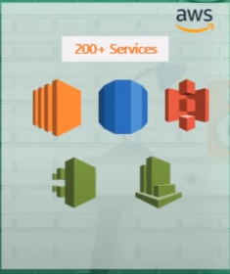
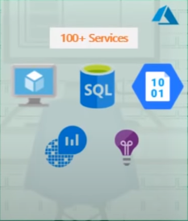
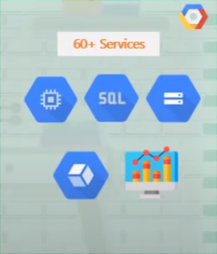
AWS vs Azure vs GCP

Slide 15
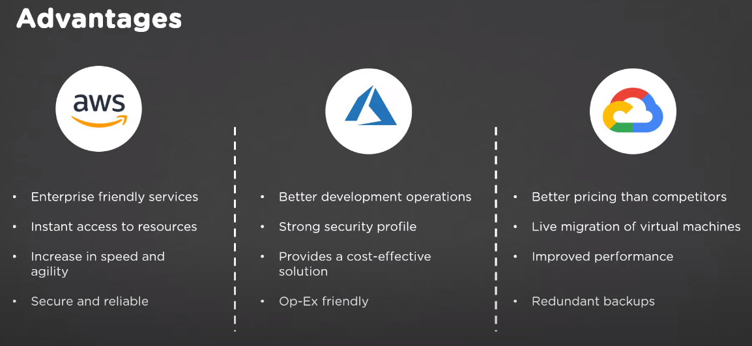
AWS vs AZURE vs GCP

Slide 16
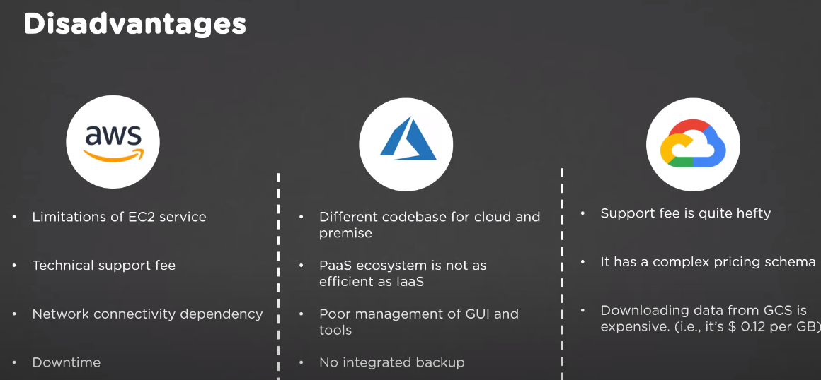
AWS vs AZURE vs GCP

Slide 17
AWS Services
EC2 Service (Elastic Compute Cloud Service)
EBS, EFS, S3
RDS
VPC
Route 53
Load Balancer
Autoscaling
Cloudwatch
CloudTrail
Elastic Beanstalk
SNS, SQS
DMS
Lambda
IAM

Slide 18
AWS Course Content

Slide 19
AWS Console
https://aws.amazon.com/console/
- Products
- Pricing
- Documentation
- Certification
- Learning path https://aws.amazon.com/training/learning-paths/

Slide 20
AWS Management Console
AWS Free Account Creation
Going through Console

Slide 21

Queries & Answers
Any Queries ??

